Slide 1
SMART PARKING
SUBMITTED BY
R.POORANAKUMAR
Department of Electronics and communication Engineering
Anna university regional campus Coimbatore

Slide 2
SOLUTION
Sensors and data analysis
To design the implementation of an sensor in parking to detect the spaces if there is an occupied or vacant we do can use an data to create an real time parking availability map that user can access the app.

Slide 3
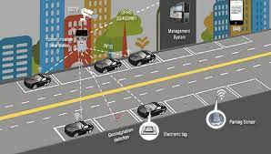

Slide 4
SOLUTION
SENSORS TECHNOLOGY
WE CAN SENSORS LIKE ULTRASONIC OR MAGANETIC SENSORS TO FIND OR DETECT VECHICLE PRESENCE IN PARKING AREA THUS THEY SENSORS CAN SEND AN REAL TIME DATA OR MESSAGE TO AN MAIN SYSTEM OR USER.
APP INTEGRATION:
CRETE AN ECO AND USER FRIENDLY MOBILE APP THAT ALLOW ACCESS THE DRIVERS TO FIND AND OCCUPIED PARKING TO FREE SPACES,AND WE CAN RECEIVE AN REAL TIME INFORMATION AND UPDATES ON AVAILABLE SPOTS.

Slide 5
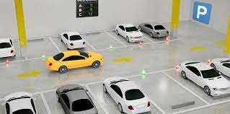

Slide 6
SOLUTION
DATA ANALYTICS
Thus the utilize data analytics to find parking demand based on historical data and the present ,this can help to optimize parking spaces allocation.
RESERVATION SYSTEM
This type of reservation method is reduce time waste and it help to reduce the crowd in parking spaces it will ensure guaranteed space for reserved persons.

Slide 7
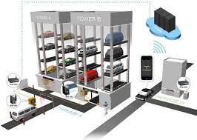

Slide 8
SOLUTION
NAVIGATION ASSISTANT:
to integrate an gps and mapping services into the app and guide the drivers to their reserved spots.
ENVIRONMENT IMPACTS:
That we can measure and display the environmental impact of using the smart parking system facility,such it can carbon emission saved.

Slide 9


Slide 10
SOLUTION
SECURITY MEASUREMENTS:
In this system we can include an surveillance cameras and emergency buttons for safety in parking spaces or area.
IOT CONNECTIVITY:
use and utilize the internet of thinks to connect various components, to making it easier to manage and monitor the parking system by remotely.

Slide 11
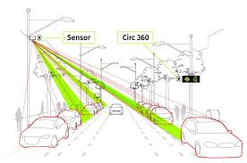

Slide 12
SOLUTION
SUSTAINABILITY:
TO consider an incorporation green initiatives like an electric vehicle charging station and eco friendly materials in parking infrastructures.
ACCESSIBILITY:
to ensure the smart parking solution is accessible to all including people with disignated accessible parking spaces.

Slide 13
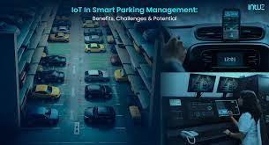

Slide 14
THANK YOU

